Slide 1
REVIEW
Lesson 9-12
Lesson 13-16

Slide 2
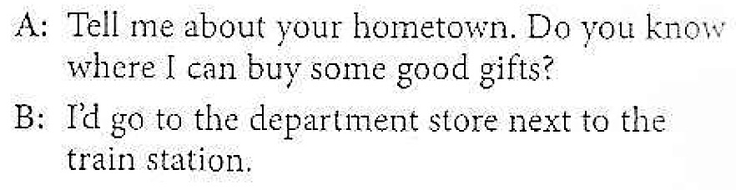
Lesson 9: Do you know...?
Student A: Ask Student B three indirect questions about places in his or her hometown.
Student B: Answer Student A’s questions.

Slide 3
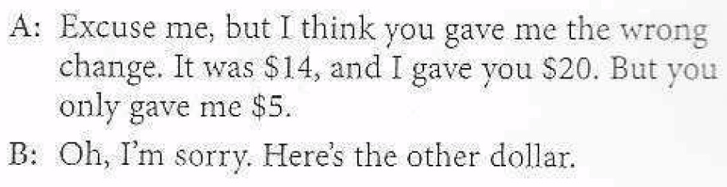
Lesson 10: Sorry. My mistake.
Student A: You are shopping. Student B is a salesclerk and overcharged you. Point out the mistake politely.
Student B: You are a salesclerk. Apologize for the mistake Student A points out to you. Fix the mistake.

Slide 4
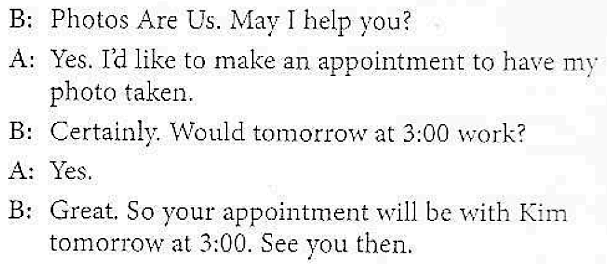
Lesson 11: Can I please...?
Student A: You want to get a professional photo taken. Student B is a photographer. Call and make an appointment.
Student B: You are a busy photographer. Student A calls to make an appointment. Make and confirm the appointment.

Slide 5
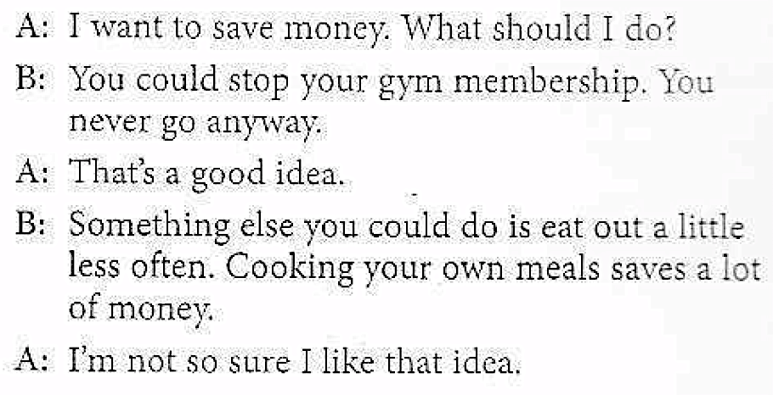
Lesson 12: I’m broke.
Student A: You want to save money. Tell Student B. Acknowledge the recommendations you hear.
Student B: Listen to Student A and make recommendations.

Slide 6
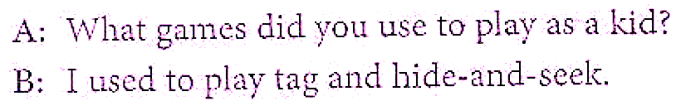
Lesson 13: I used to play hopscotch.
Student A: Ask Student B to tell you two things he or she used to enjoy doing as a child. Ask follow-up questions.
Student B: Tell Student A about two things you enjoyed when you were a child.

Slide 7
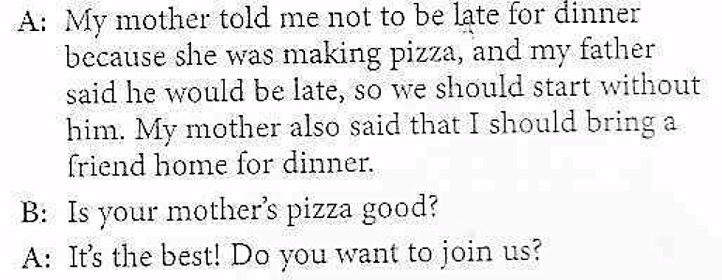
Lesson 14: She said she was sorry.
Student A and Student B: What were the last three things a friend said to you? Try to remember. Take turns reporting what he or she said. Ask follow-up questions.

Slide 8
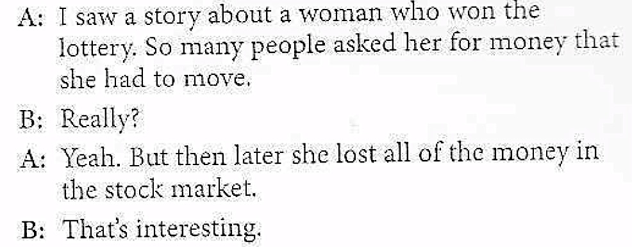
Lesson 15: I read an unusual story.
Student A and Student B: Take turns talking about something you’ve heard in the news recently. Be sure to add information to make the story interesting.

Slide 9
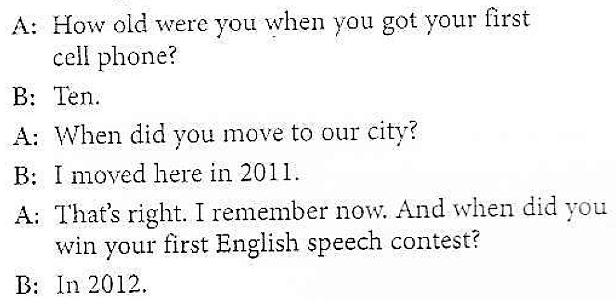
Lesson 16: When did they release it?
Student A: Ask Student B three questions. Ask when key events happened in his or her life.
Student B: Answer Student A’s questions.

Slide 10


